Slide 1
Project
E-Commerce Store
Description:-Have a Brazilian e-commerce store data over the 3 years period of time .I visualize the data and complete a analysis by using the MySQL server to complete this analysis.

Slide 2
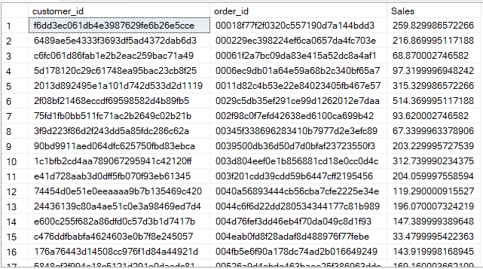
Insights 1:- It Shows the Total sales as per order id.

Slide 3
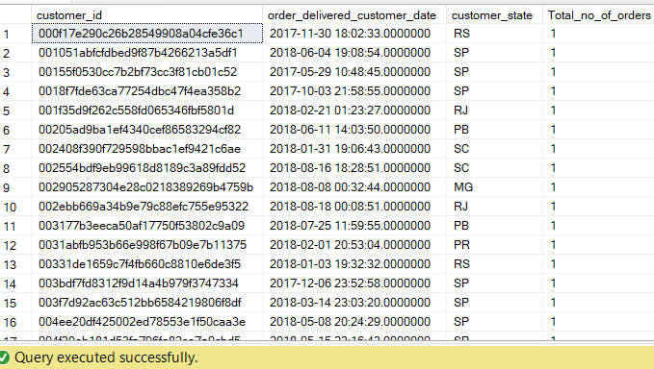
Insights 2:- It Shows the Total orders of customers as per state.

Slide 4


Insights 3:-It Shows the Top 2 states by declining the trend over the years
It Shows the Top 2 state by Increasing the trend over the years.

Slide 5
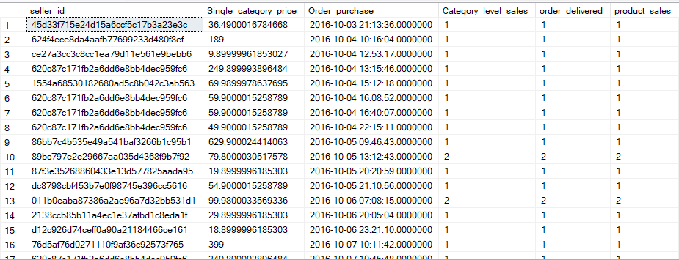
Insights 4:-It Represents the number of orders is delivered by the seller as per the order purchase.

Slide 6


Insights 5:-It Shows the % of the orders is delivered before the actual Date and Time.
It Shows the % of the orders is delivered after the actual Date and Time.

Slide 7
THANK YOU

